Slide 1
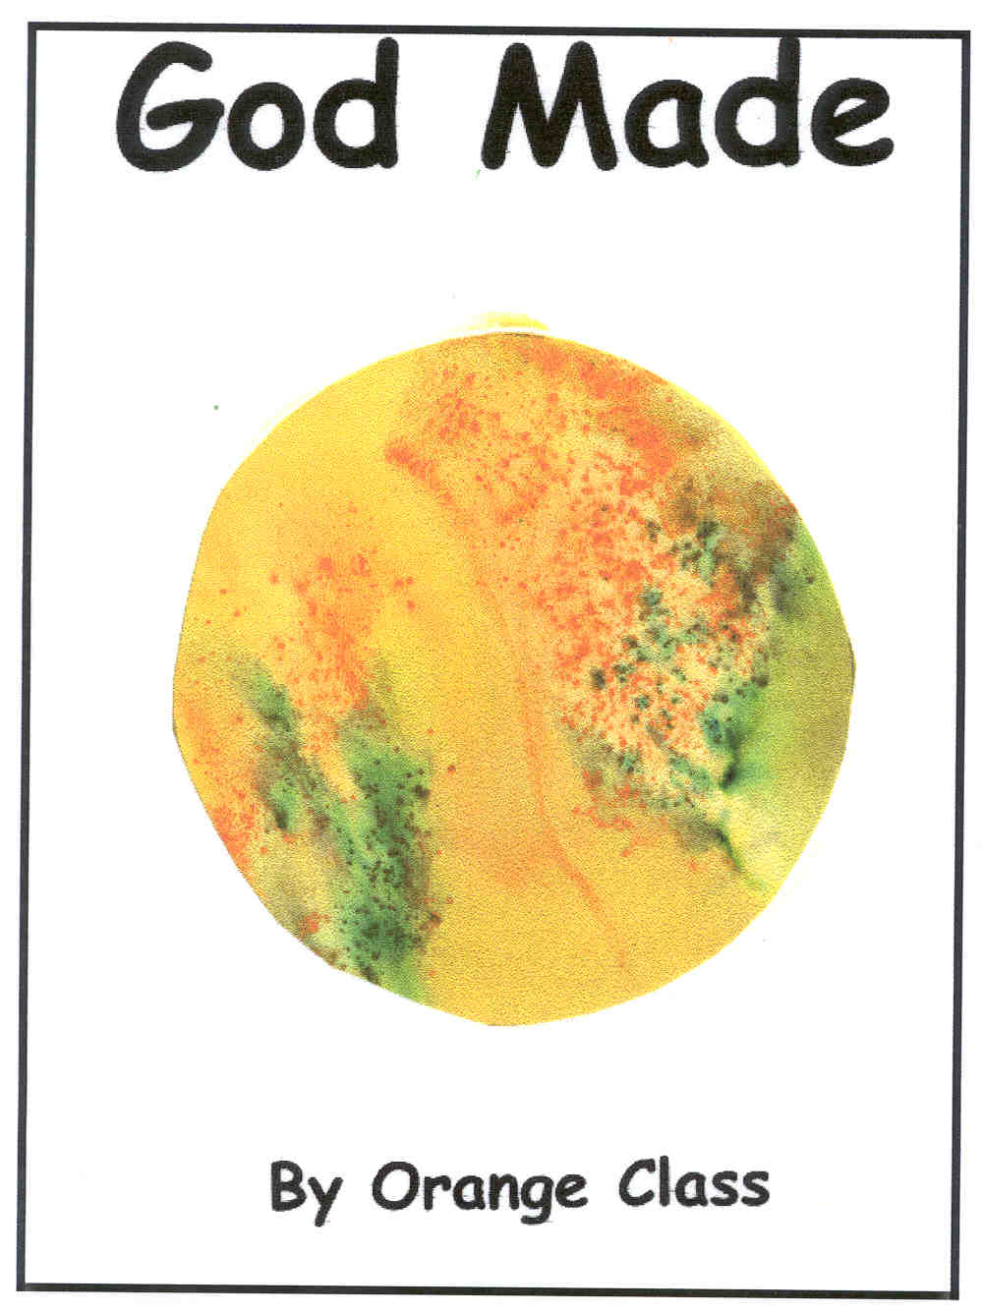
_______’s story
Photo of young person

Slide 2
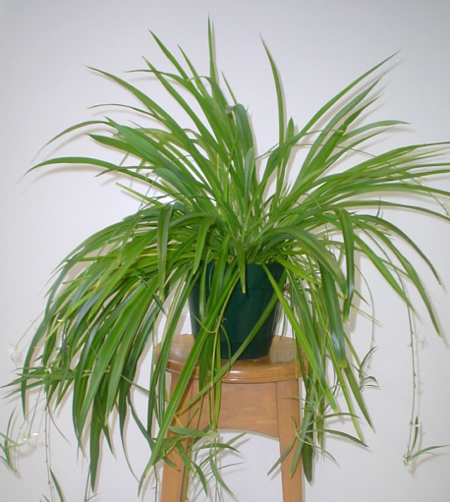
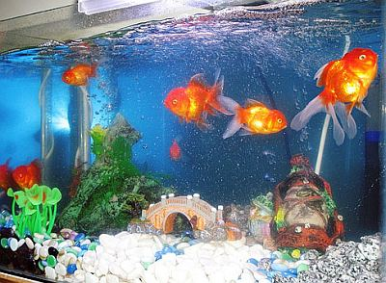
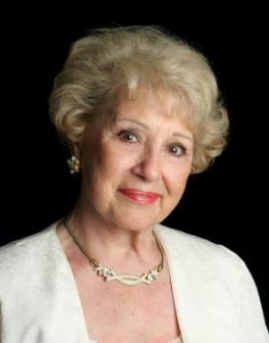

These things are alive.

Slide 3
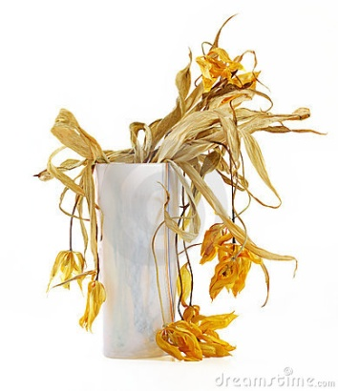
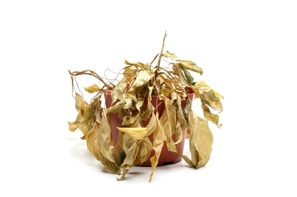
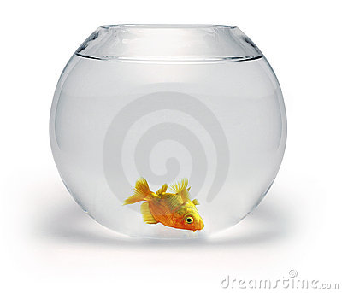
Death is a part of life.
When someone dies, everything inside that person stops.
They stop breathing and their heart stops.
They cannot feel any hurt.
Everyone and everything that is alive dies at some point.

Slide 4

_________ might feel sad because she misses ___________.
When someone dies people feel sad.
Feeling sad is ok.
_________________has died.

Slide 5
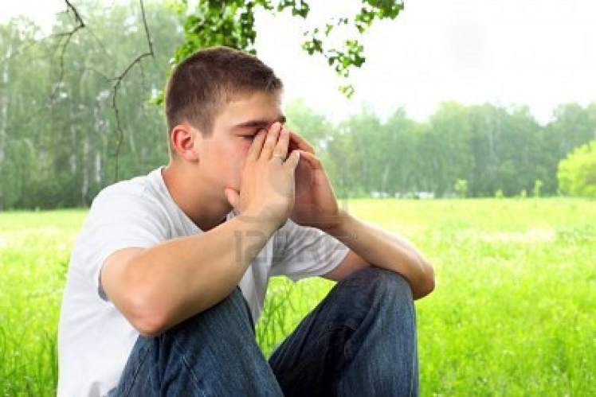
When someone dies, people cry.
Crying is ok.
Sometimes after you cry you don’t feel as sad.
_________ might cry.

Slide 6
_________ might feel angry because she misses ___________.
When someone dies people feel angry because they miss them.
Feeling angry is ok.

Slide 7
In a few weeks, ________ may not feel as sad.
Time helps you feel better.
It’s ok to feel better.
I could help ____________ by:
Giving cuddles.
Tidying up.
Washing up.

Slide 8
Created by the
Teachers

