Slide 1

__________’s going on holiday story
Photo of young person

Slide 2
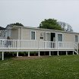
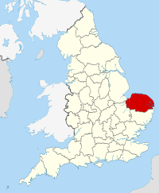
______ is going on holiday with __________ to a caravan park in Norfolk.

Slide 3
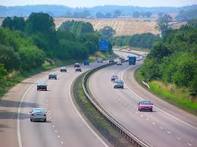
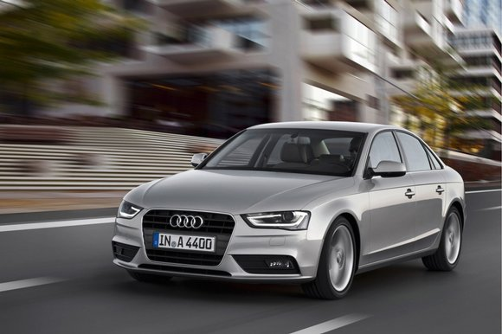
_________ will travel by car to the caravan park.
_________ will travel from home to Norfolk on the motorway.
The journey will take a long time.

Slide 4
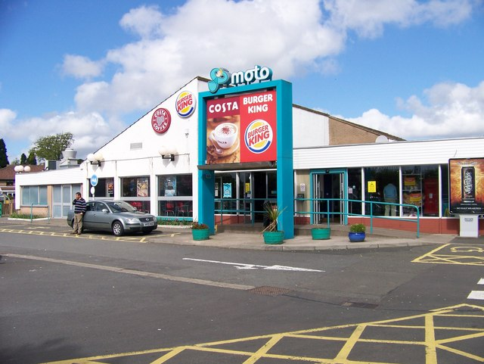
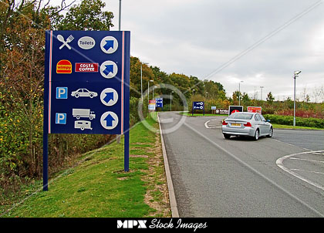
____________ will stop at a service station to buy a snack and go to the toilet if he needs to.

Slide 5
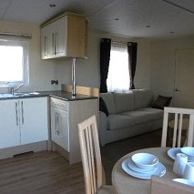
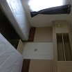

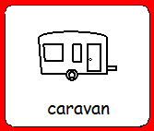
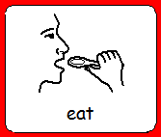
At the caravan park ____________ will sleep in the caravan.
__________ will have meals in the caravan.

Slide 6
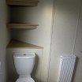
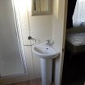
In the caravan Jaecan will have to wash in the bathroom.
In the caravan Jaecan will have to use the toilet to wee and to poo.

Slide 7
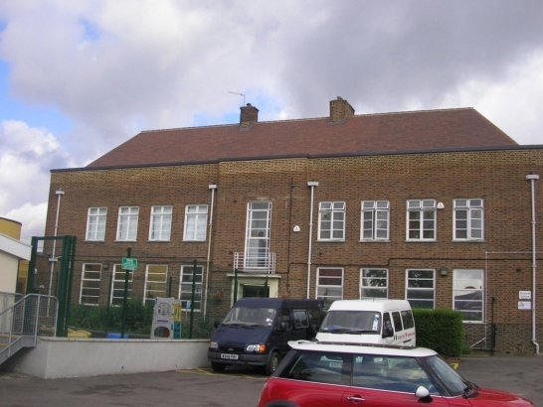

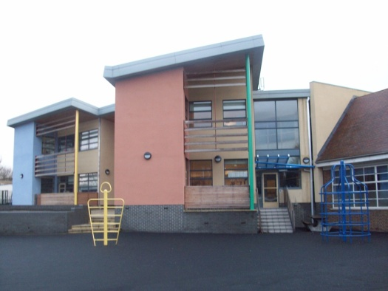
When __________ is in Norfolk there will be no school for __________.

Slide 8

When the holiday is finished __________ will travel back home.
Photo of home

Slide 9
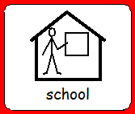
When __________ is back at home he will be going to school.

Slide 10
Created by the
Teachers

