Slide 1

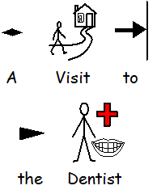
______’s Story

Slide 2

My name is _____.
This is my story about learning to go to the dentist.
Photo of young person

Slide 3
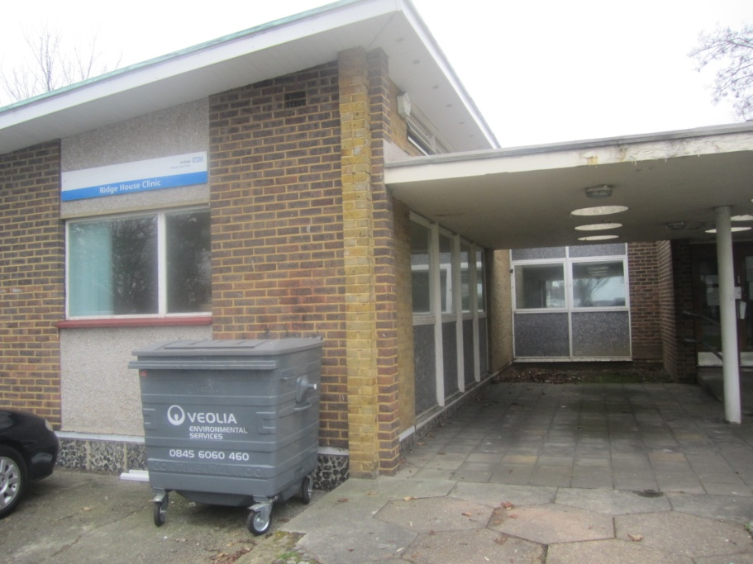
This is the Dentist’s surgery.

Slide 4
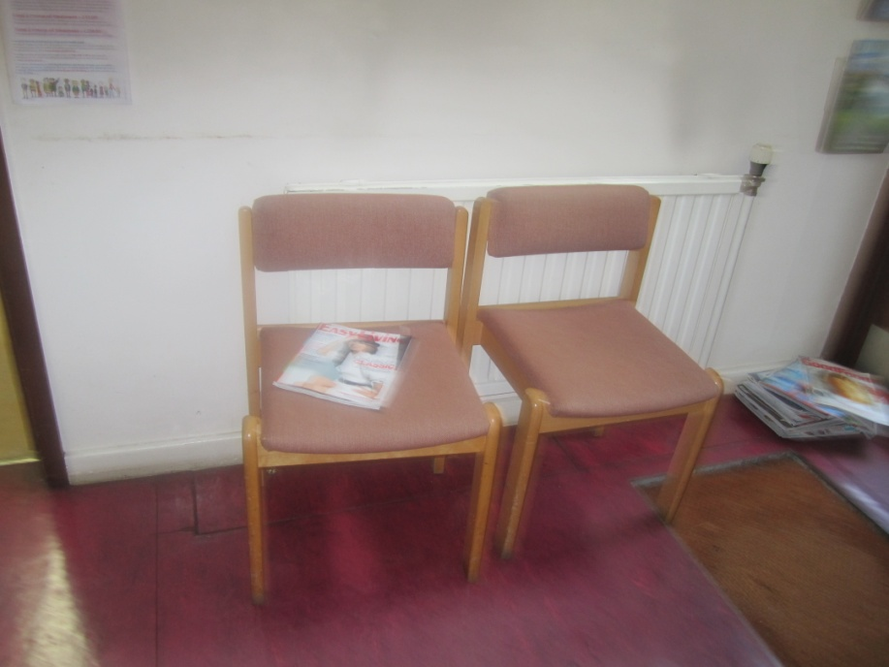
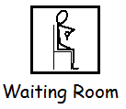
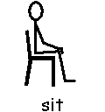
In the waiting room there will be a chair.
We will sit down and wait here to see the dentist.

Slide 5
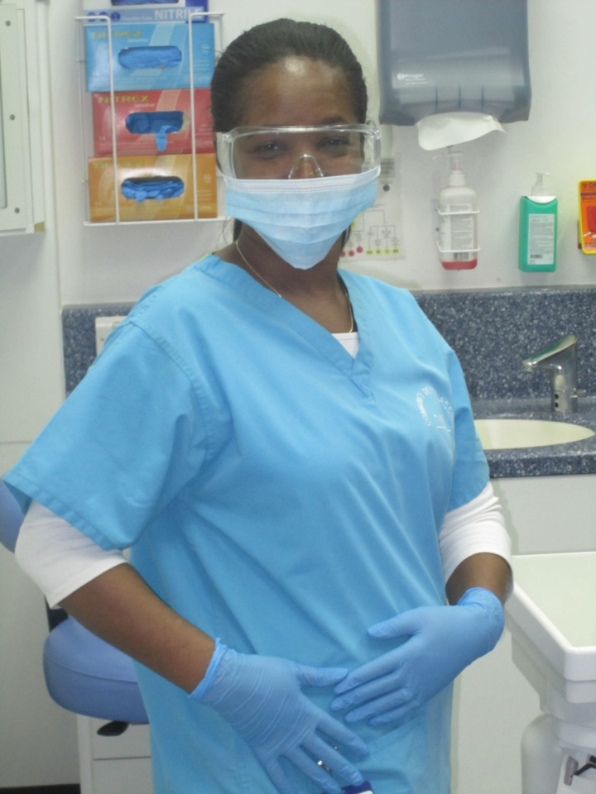
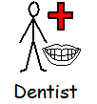
This is a Dentist. This dentist is wearing gloves and a mask to keep clean.
The dentist I see might have a mask on and be wearing gloves.

Slide 6
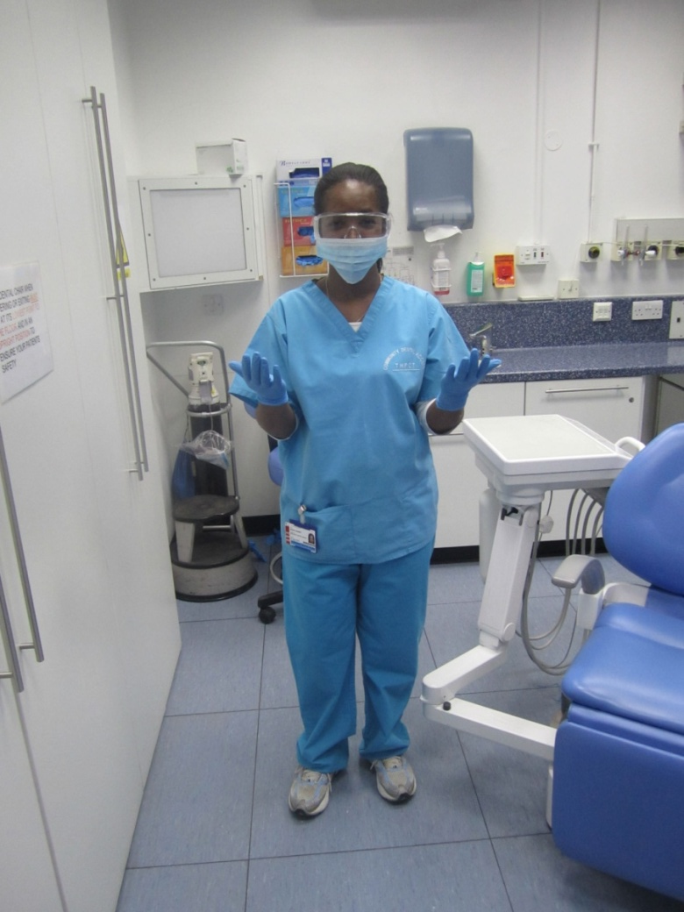
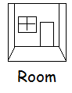
This is the Dentist’s Room. It has special equipment in it to help look after your teeth.
The dentist room I go to will have special equipment in. Some of the equipment might make a noise.

Slide 7
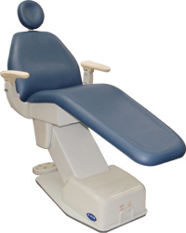
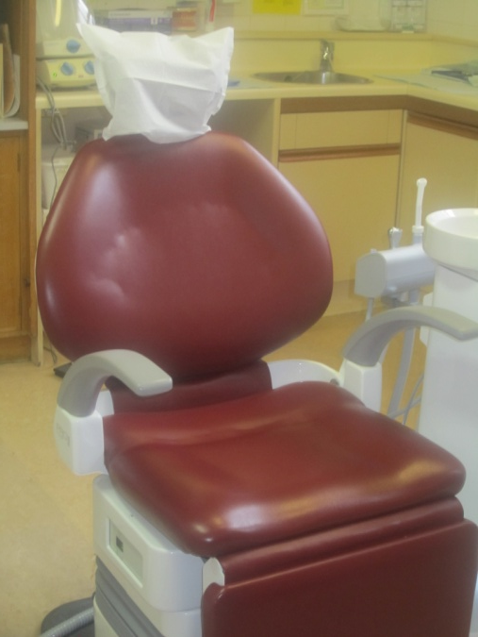

These are dentist chairs. Dentist chairs can be different shapes and colours. A dentist chair tips you back so that the dentist can look in your mouth.
I will sit in the dentist chair and the chair will go back to help the dentist look in my mouth.

Slide 8
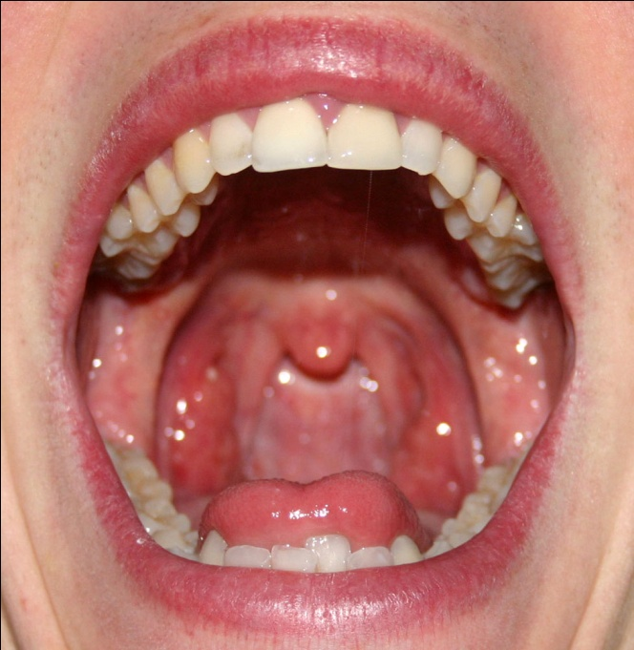
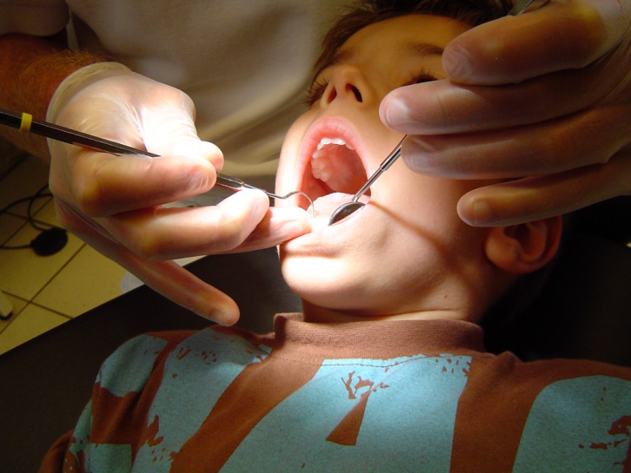
The dentist will need me to open my mouth wide so they can count my teeth and make sure they are healthy.
It is important to have healthy teeth so that I can eat food.
The dentist will need to put a little mirror in my mouth to help them to check my teeth are health.

Slide 9
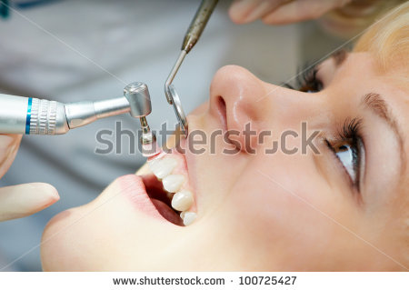
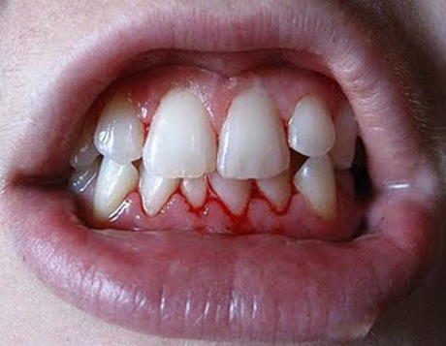
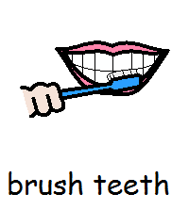
The dentist will clean my teeth with a special brush. The brush will make a noise and might tickle.
My gums might bleed this is ok it is just where the dentist is cleaning them.

Slide 10
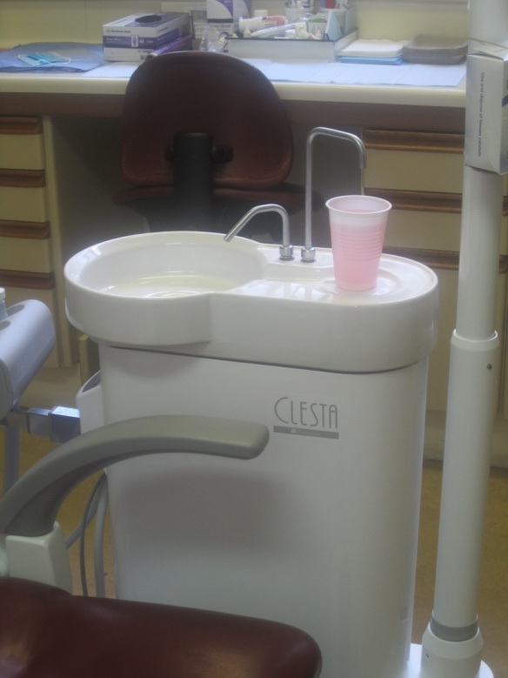
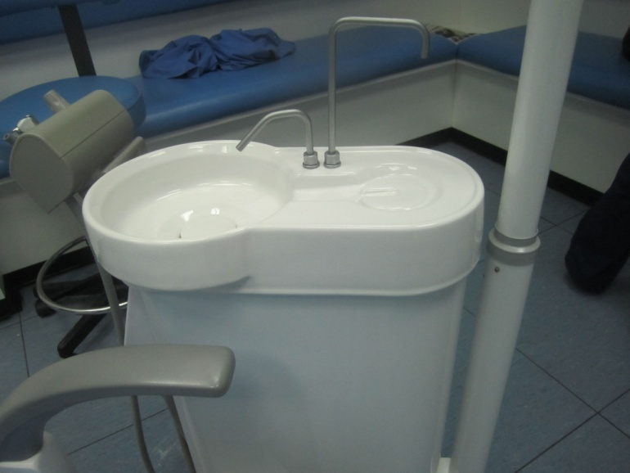
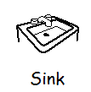
These are dentist sinks that may be in the Dentist’s Room.
I can use it to wash my mouth out when the dentist has finished checking my teeth.

Slide 11
I will be going to the dentist with Mummy.
Mummy will help me.
It is important that my teeth stay healthy.
The dentist will help my teeth stay healthy
Photo of young person

Slide 12
Created by
Your Class
with a little help from
the
Teachers

