Slide 1

Durants School
Southgate
Rachel Carli
Head Teacher

Slide 2
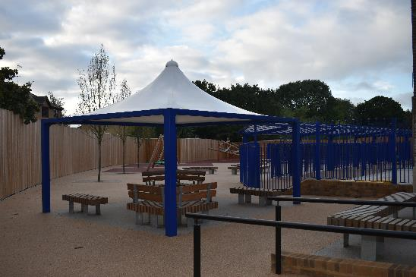
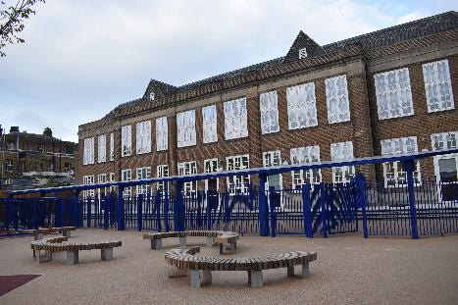
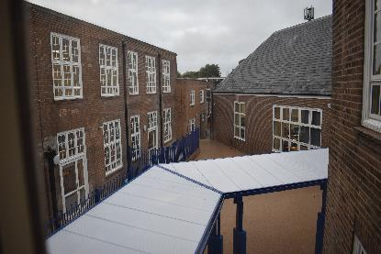

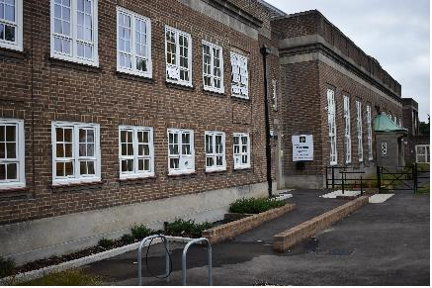
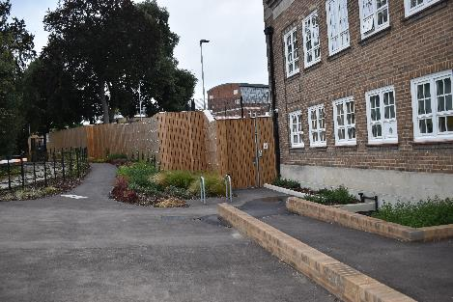
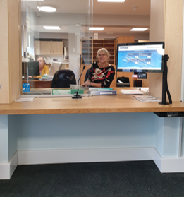
Welcome to
Durants School
Southgate

Slide 3
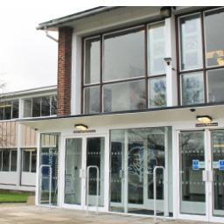



Durants school is a maintained Special Secondary school for pupils with Autism. It is funded by the London Borough of Enfield, currently there are 127 pupils on roll.
We, as a special needs school are privileged to have recently moved into a brand new site is Southgate, which was developed and funded by Enfield Local Authority.
As well as the Southgate site, Durants School also has an Additionally Resourced Provision (ARP) at Winchmore School.
Social communication is at the heart of our curriculum and is intrinsic to all learning opportunities. All pupils also receive on-going teaching with relation to behaviour and managing their own emotions and learning self-regulation. In addition, we recognise the importance of ensuring our pupils learn essential life skills so that they develop the skills and independence they need to make progress towards adulthood. This includes creating opportunities for our pupils to generalise their knowledge and skills by using them in real-life situations.

Slide 4
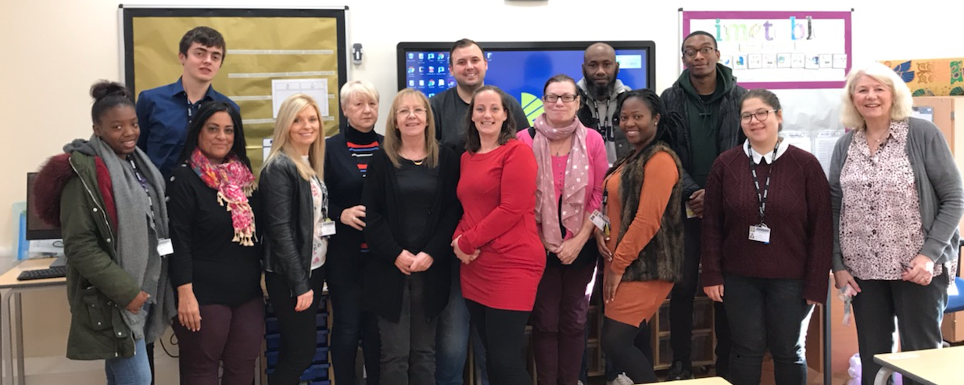
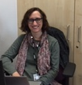
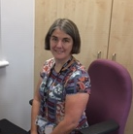
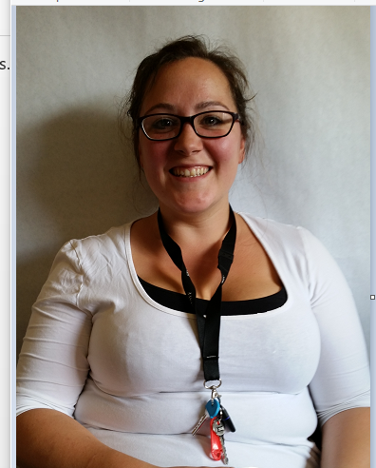

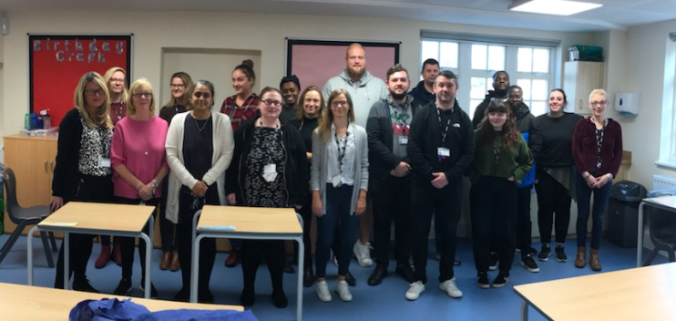
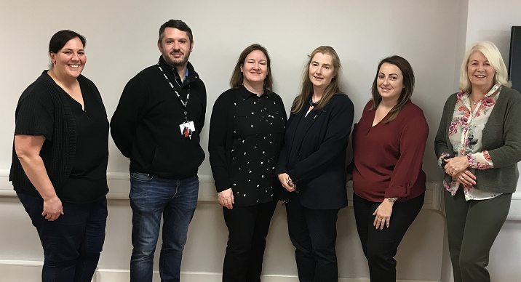
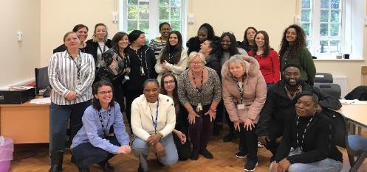
Upper department
Therapists
DURANTS STAFF
Middle department
SLT
Lower department

Slide 5
Our Values and Principals
Friendships, Relationships & Community
For all students to have regular access to the community
To support the development of friendships and relationships that suit each individual
To support the understanding of social rules and behaviour.
Independent Living
For all students to do as much for themselves as possible
To provide routines, structures and communication strategies to promote independence
To support all students to be safe
Employment
To develop individual skills for future work
To provide work placements in the community, that meets the needs of all pupils.
To develop and foster relationships with suitable external employers.
Good Health
To have access to appropriate and necessary health care.
Having a healthy diet and regular exercise.
Access to services that promote emotional well-being and good mental health.
The strength of Durants lies in the quality of our staff, who work relentlessly to improve the outcomes and life chances of all our pupils.
Our commitment is to work in partnership with our parents to maximise the potential of all our pupils and prepare them for the transition to adult life.

Slide 6
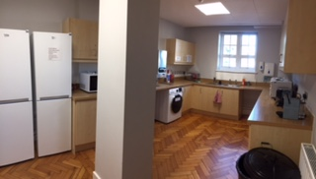
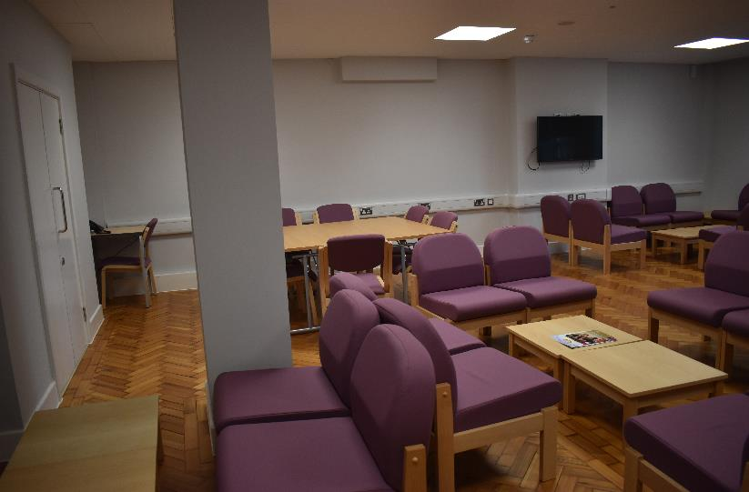
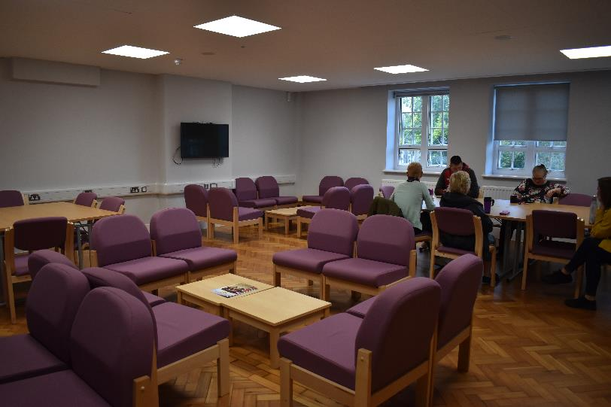
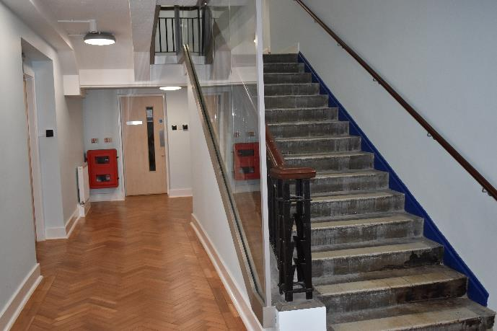
Kitchen
This new building has given the staff, a large staffroom, a kitchen area
Many of the original features have been saved and incorporated into the new refurbished building.
Staff room

Slide 7
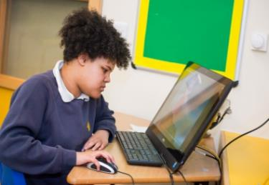
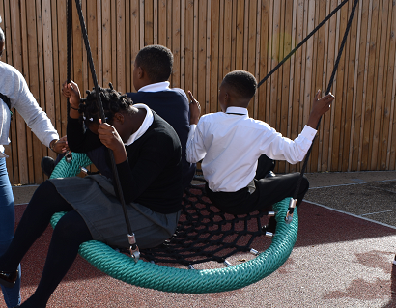
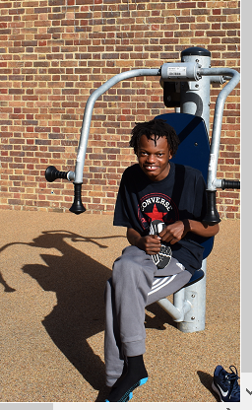
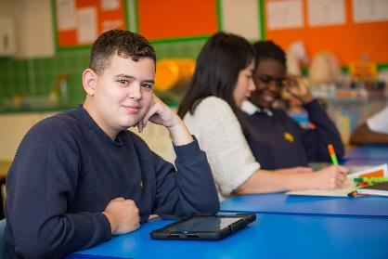
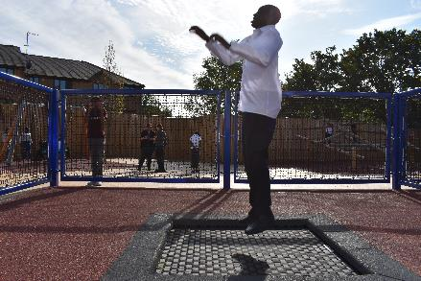

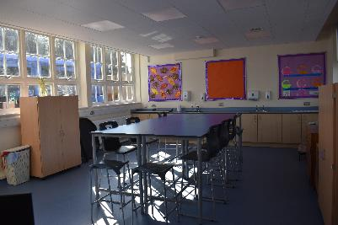
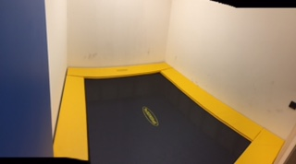

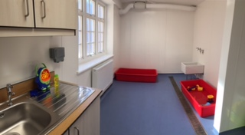
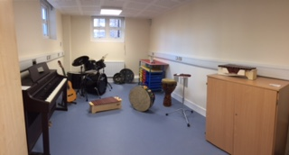
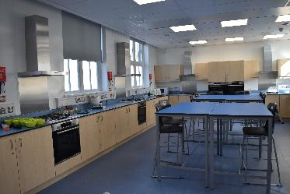

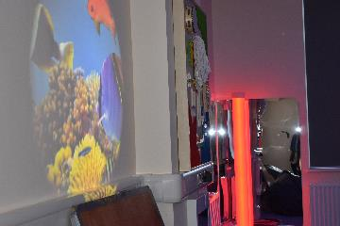
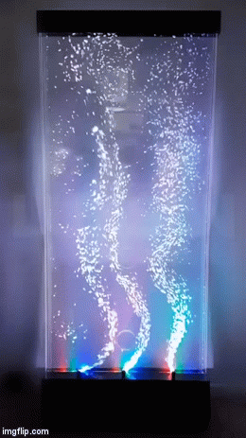


Durants state of the Art Autism Provision
We offer a bespoke curriculum enabling our pupils to achieve to their full potential, utilising their individual learning styles. The curriculum consists of core subjects, Humanities, Art, Food Tech, ASDAN, AQA Units, AET targets as well as a bespoke Assessment tool to monitor achievement. Our post 16 provision equips pupils for adulthood incorporating “Preparing for Adulthood” curriculum.
This state of the art autism provision has fantastic facilities such as: A rebound therapy room, Sensory room, life skills and creative art rooms, a sensory water room, a music therapy room and a thoroughly equipped sensory integration room plus a common room for post 16 pupils.

Slide 8
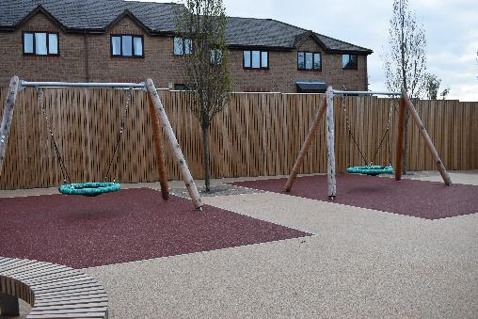
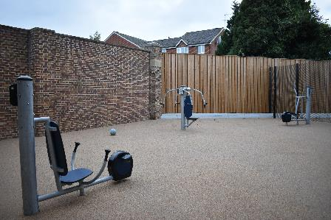
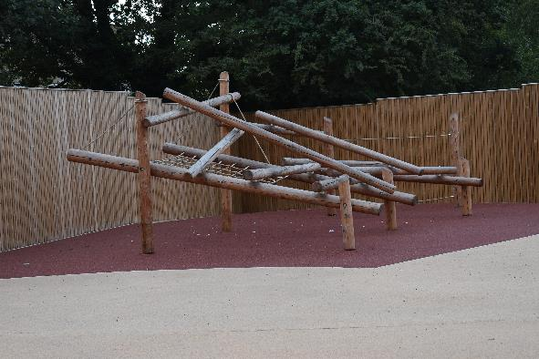
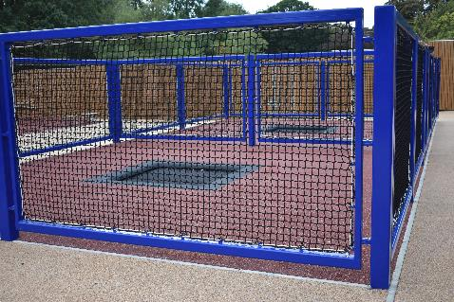

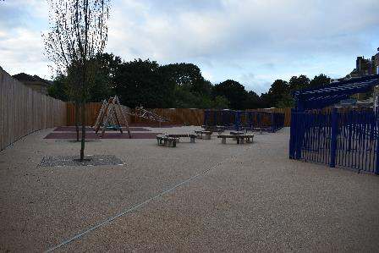
Outdoor facilities consist of two basket swings, two trampolines, a wooden climbing frame, a small area with outdoor exercise equipment and shaded and unshaded seating areas.

Slide 9
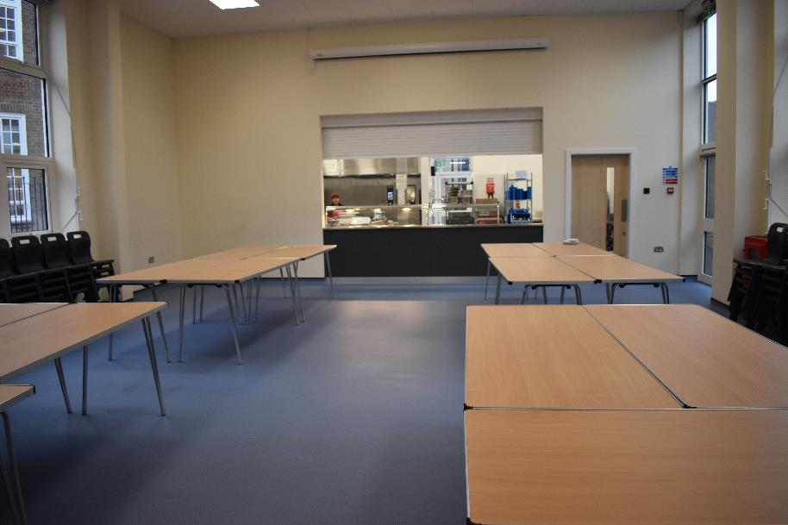
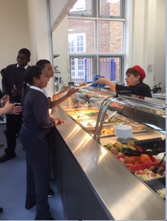
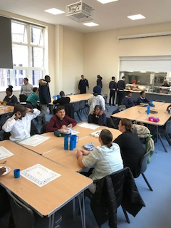
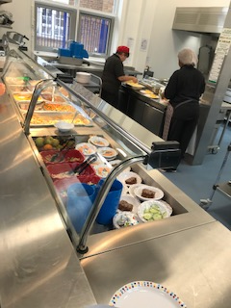
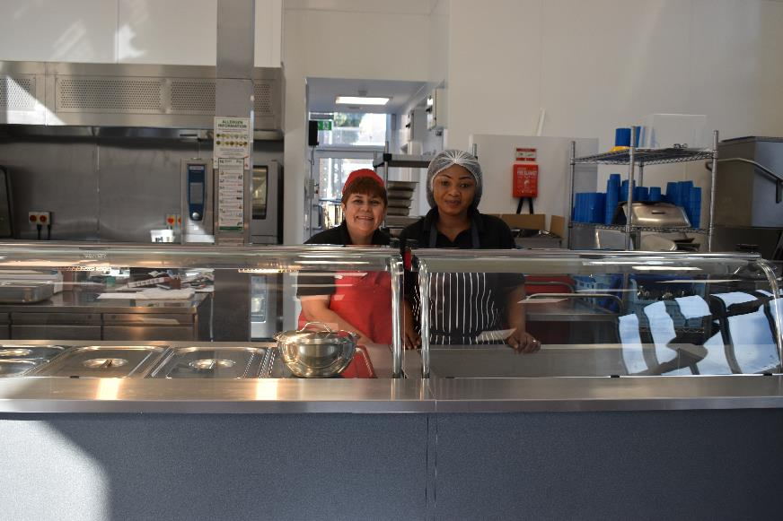
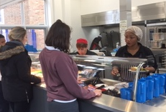
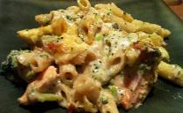
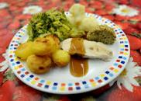
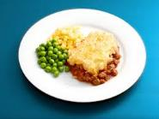
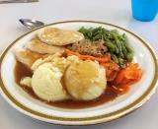
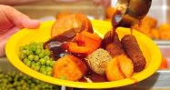
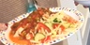
Pupils can enjoy their new canteen with dedicated catering staff to look after the dietary needs during school lunchtime.
This building has its own restroom area plus two smaller eating areas to cater for those who are unable to eat in larger groups.

Slide 10
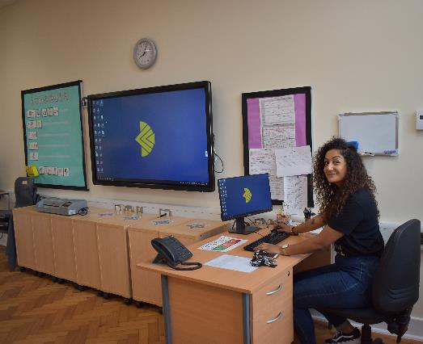
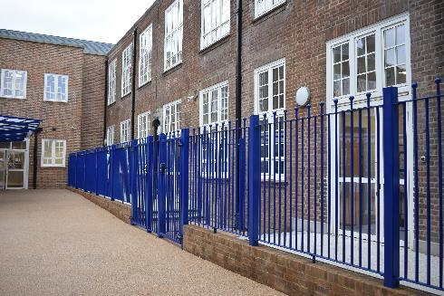
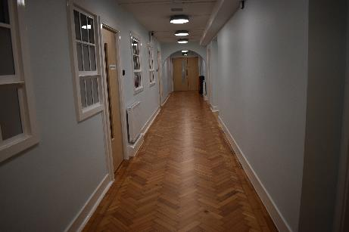



All classrooms are spacious and bright with high tech equipped, smart boards and other ICT equipment to enhance learning. Most class rooms have a quiet room, resource room and a sink unit. The corridors are calm and welcoming.
Classrooms on the ground floor have ample outside spaces which lead onto the front or back playgrounds.
Each classroom has been named after famous people with Autism, who have proved to be outstanding in their chosen profession. This is honoured by a plaque on the classroom doors giving a brief description of what they have achieved in their field.

Slide 11









The school is also supported by non teaching staff who look after the premises, the technical equipment, the office, the canteen, business and financial side of Durants during the working day and out of school hours, keeping everything flowing smoothly.

Slide 12



Positive Behaviour Support (PBS)
With morning schedule
Durants school has adopted the PBS (Positive Behaviour Support) approach. The focus of Positive Behaviour Support is on supporting pupils to be happy and to participate within their family, school and community. Recognising the things that help a pupil to be happy and supporting them with this will help their participation in meaningful activities and use of positive ways to communicate. Durants School is adapting the framework provided by “The Zones of Regulation: A curriculum designed to foster self-regulation and emotional control”. This promotes a focus on understanding the emotional state of the pupil and focusing on the personalising the proactive strategies that support each pupil to be happy, calm and ready to participate & learn.
Individual
Wall chart

Slide 13
I would like to express my sincere gratitude
to all involved
for making this journey a wonderful success
in creating our new bespoke Autism provision
in Southgate.

